Slide 1



Research agenda MOHAMMAD ADIBUZZAMAN
Notes:
Causally-driven Healthcare Science
From Observational and Experimental Studies to Personalized and Improved Patient Outcomes

Slide 2
outline
Machine Learning for healthcare
Hemorrhage Detection
Evaluation of Machine Learning Algorithms
Compute Framework
Causal Inference

Slide 3
next generation computing and methodological framework
Different dimensions (EHR, genomics, imaging) and study designs (selection bias, confounding bias, etc.) of data
Observational data (non-experimental big data): highly biased (confounding), big data
Randomized controlled trial (experimental data): Lack of external validity or generalizability
How do you combine data (compute framework and statistical/causal framework) to estimate causal effect for interventions?
Notes:
Q: Does the proposal address a challenging, leading edge question in data science fundamentals and/or application in the areas of interest to the solicitation?
Does the proposal address a challenging, leading edge question in data science fundamentals and/or application in the areas of interest to the solicitation?

Slide 4
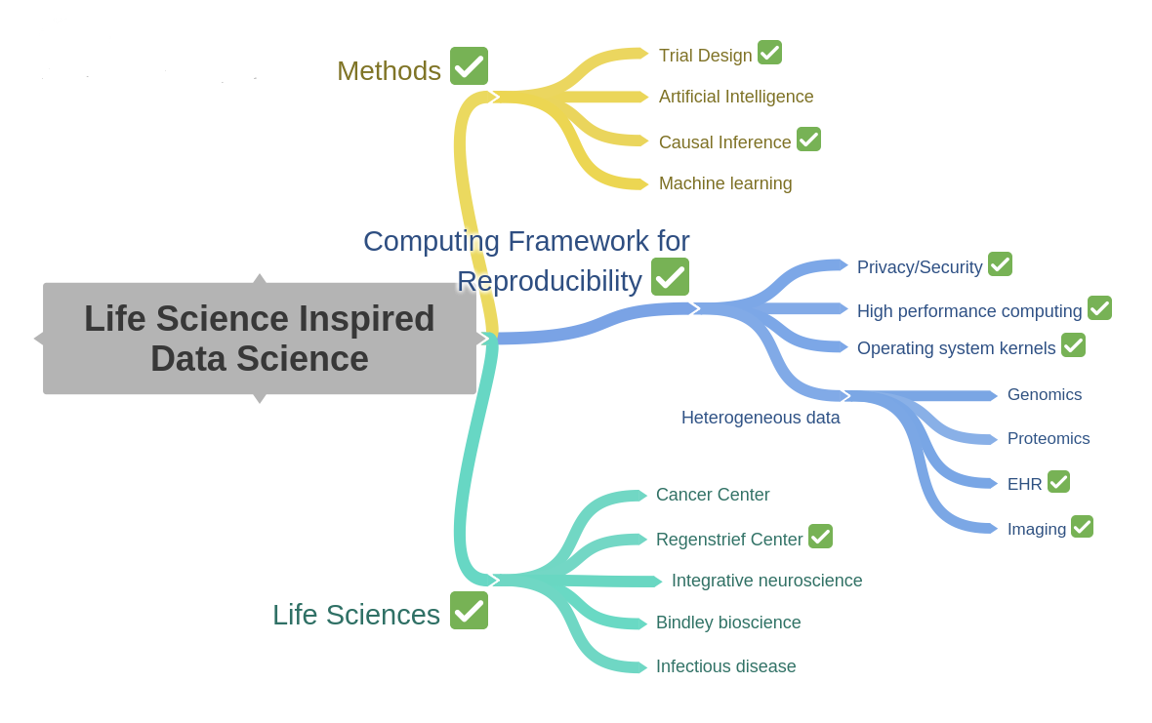
HERE WE ARE

Slide 5
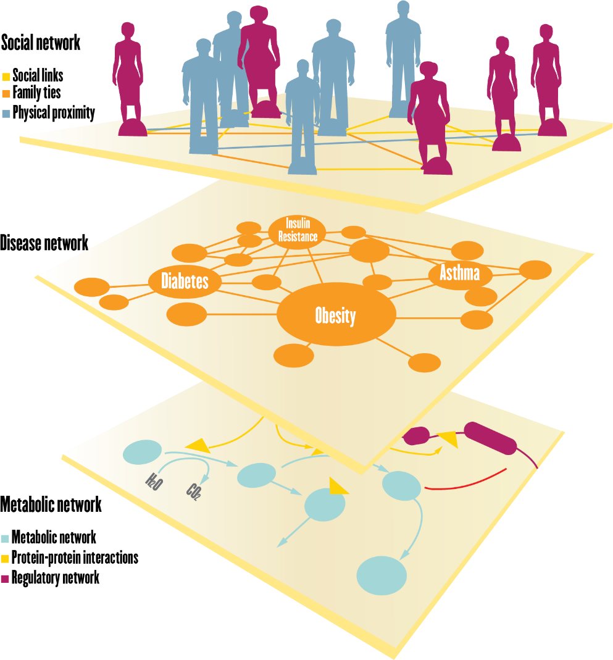
Big Picture
Dimensions of Life Sciences
Dimensions of Data Sciences
Data
Dimensions
Time

Slide 6
Computing Framework

Slide 7
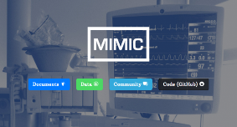


Compute framework: Current system
Open source technology
Scalable system
300TB data storage and computation
Currently supports SQL, images, time series
Demo
MULTIPLE DATA SOURCES
MIMIC III (Beth Israel Hospital EHR)
Cerner Health Facts (60M patients over 18 years)
Claims data
Indiana Medicaid (2012 to present)
Purdue Community (staff and families)

Slide 8
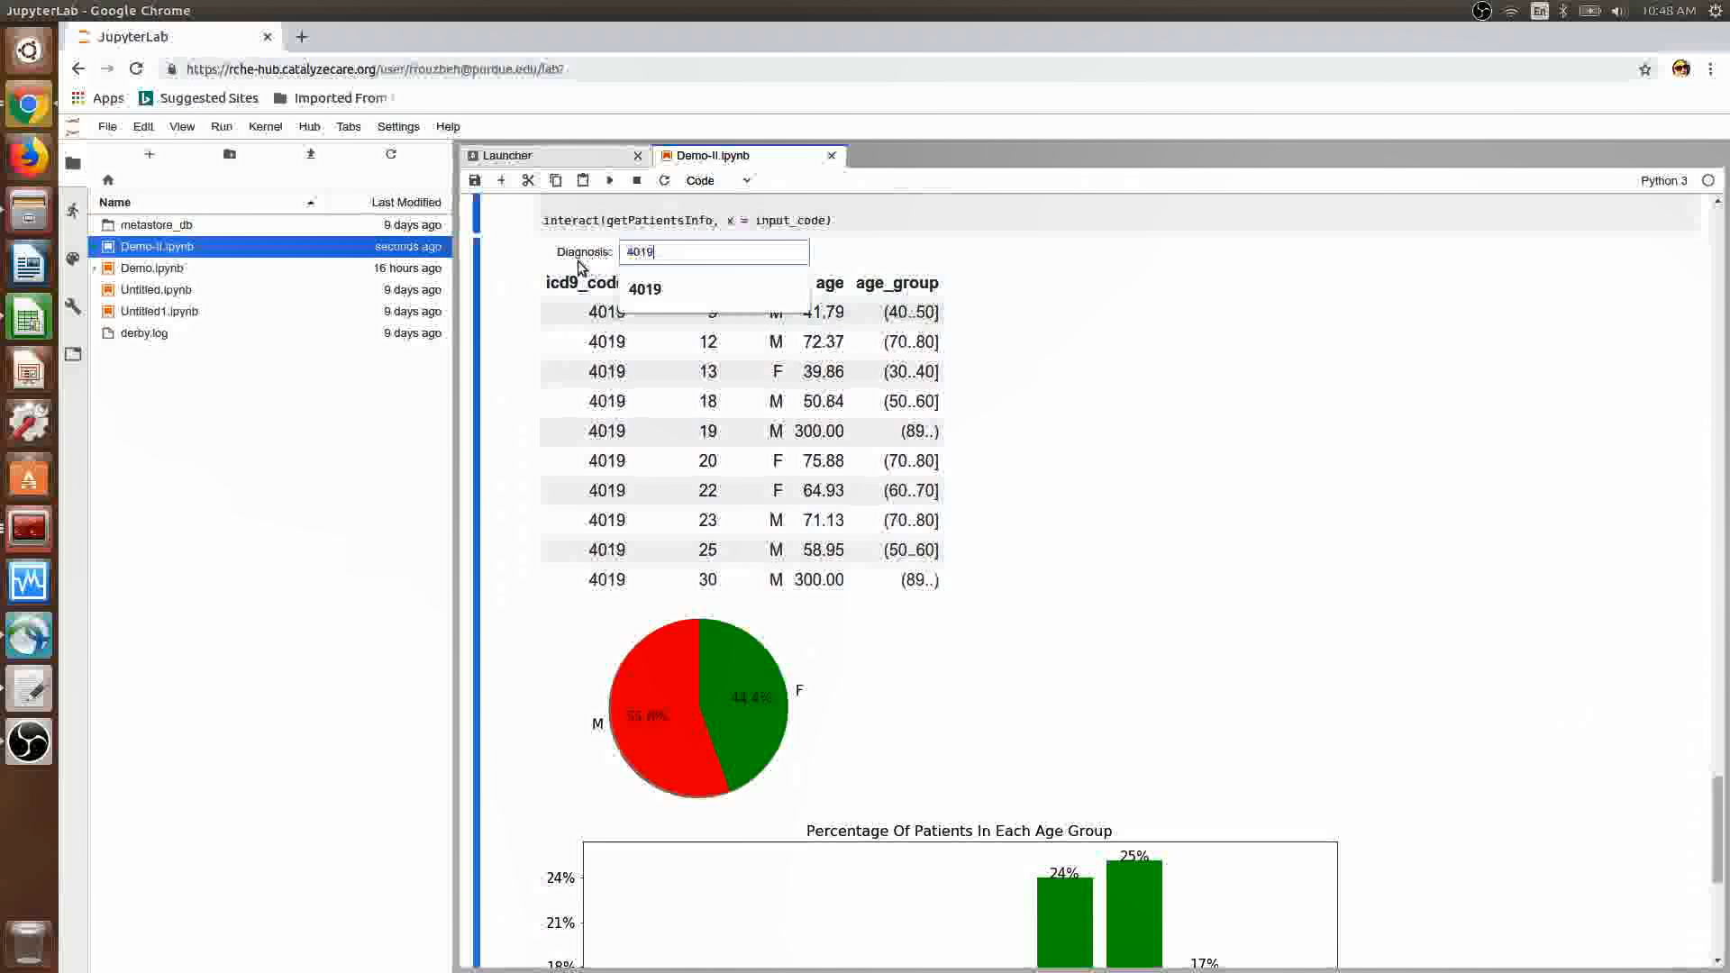
Current system

Slide 9
Causal Inference
Heart Failure, Acute Respiratory Distress Syndrome, Oxygen Therapy and Delirium Treatment

Slide 10
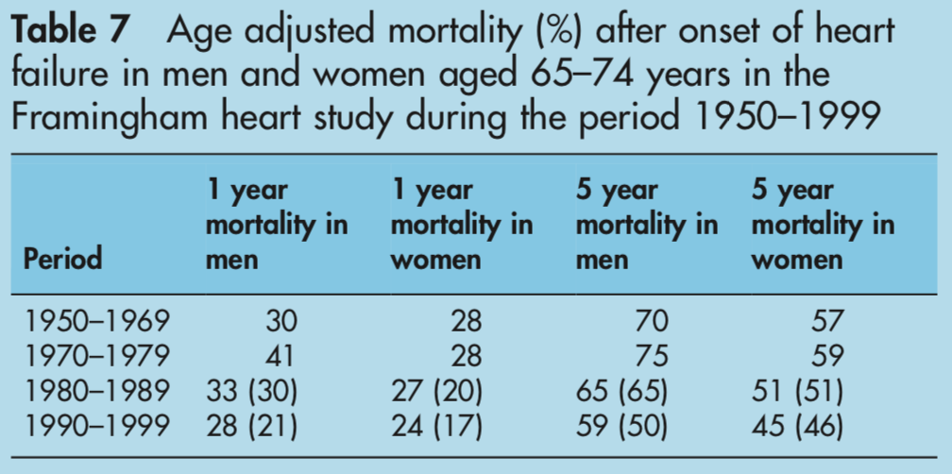
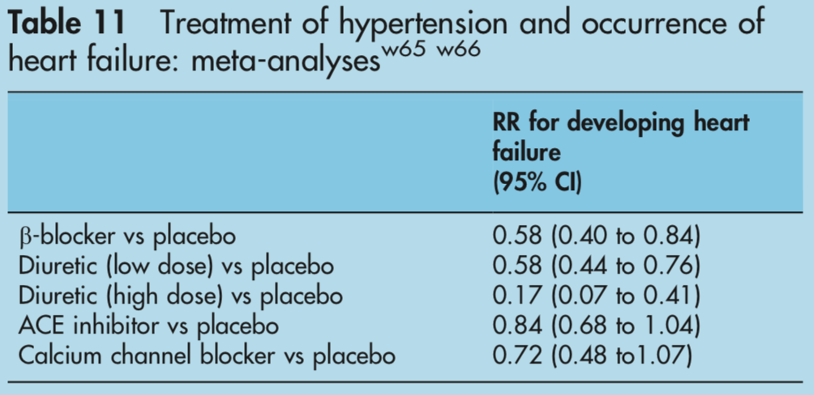
Heart failure (HF) is a major health and financial concern for the us adult population
~6 million adults > 18 years old have HF¹
Expected to exceed 9 million by 2030²
50% of HF patients die within 5 years³
HF financial: ~$31 billion dollars annually^{1,2}
Furthermore, 50% of HF patients suffer from diastolic HF³ - HF with preserved ejection fraction
20% misdiagnosis rate of HF! *⁴
*Current research of this number is limited and may be underestimated
(Mosterd & Hoes, 2007)

Slide 11
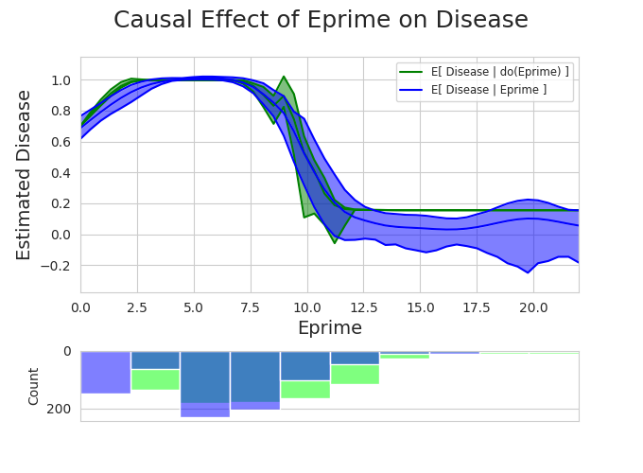
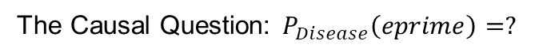
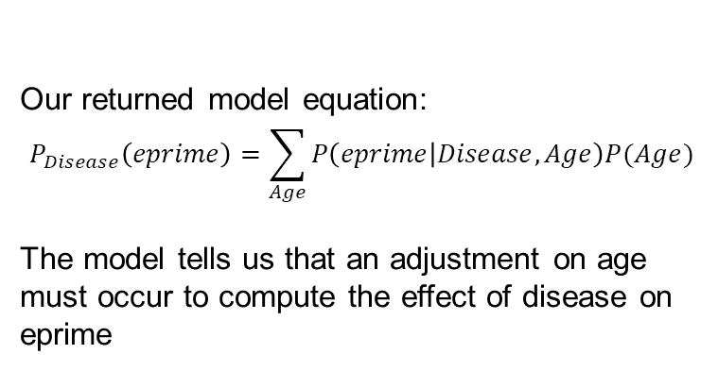
Causal effect of e-prime ON Disease
The Causal Question: $P_{Disease}\left(eprime\right)=?$
The model (green) based on the do-calc. versus the observations (blue)
Our returned model equation:
$$P_{Disease}\left(eprime\right)=\sum_{Age}{P\left(eprime | Disease,Age\right)P(Age)}$$
The model tells us that an adjustment on age must occur to compute the effect of disease on eprime

Slide 12
Example research projects
Google Health - https://ai.google/healthcare/
Nature Medicine – Sepsis –(Infectious disease with EHR) https://www.nature.com/articles/s41591-018-0213-5
PNAS – Data Infrastructure -OHDSI https://www.pnas.org/content/113/27/7329

Slide 13
competition
PIC-SURE – Harvard precision medicine
https://pic-sure.org/training/graduate-level-courses/precision-medicine-ii
All of us- NIH precision medicine
Vanderbilt, Broad and Verily (Google)
https://www.joinallofus.org/en
OHDSI- Columbia, Stanford, IU Health consortium
https://ohdsi.org/
iDASH- UC San Diego
https://www.ncbi.nlm.nih.gov/pmc/articles/PMC3277627/
None of them has the engineering and computer science strength that Purdue has to build the next generation systems

Slide 14
Funding opportunities
All of us- 10 year (at least) for One million patients
Already awarded ~200M and much more to come
https://allofus.nih.gov/
Million Veterans Program (MVP)- One million patients
https://www.research.va.gov/mvp/
NIH NHLBI – TOPMED- ~100K patients with genomics information
https://www.nhlbi.nih.gov/science/trans-omics-precision-medicine-topmed-program
NSF
Industry
ROCHE
Google
Lilly
Microsoft
Amazon
DARPA
Foundations
Howard Hughes
Broad
Sloan Kettering

Slide 15
WHERE DO WE GO
Short term (Achieved)
Teams formed
Computing framework developed- 300TB capacity
Data and clinical partners established- Cerner, IU, NGHS
Mid term (Ongoing- by 2020)
NIH, NSF, Industry funding- $5M
Long term
$200M in sponsored funding in the next 5-10 years

